Slide 1

Movie Industry Data Analysis
A Business Advisory project on setting up a movie studio

Slide 2
Project Overview
Goal: Help a new movie studio make data-driven production decisions
Approach: Analyze historical movie data to answer 3 key business questions

Slide 3

Business Questions
1️⃣ What genres tend to perform best at the box office?
2️⃣ Do critic ratings predict box office success?
3️⃣ How do budget levels correlate with box office revenue?

Slide 4
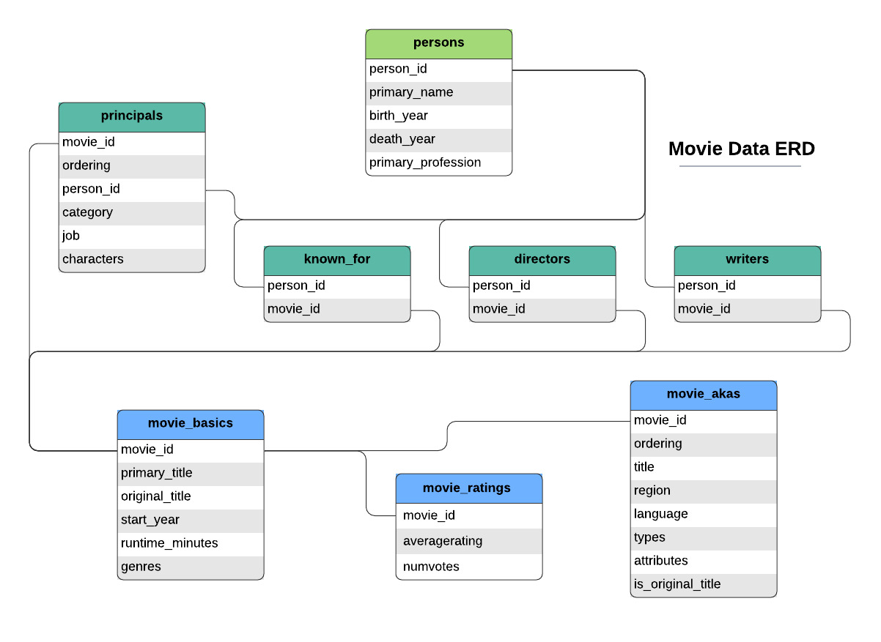
Data Sources
IMDB (movies, ratings)
BOM (box office revenues)
The Numbers (budgets)
Rotten Tomatoes (reviews)

Slide 5

Data Cleaning Summary
Cleaned currencies and missing values
Exploded multi-genre fields
Filtered low-vote movies
Merged datasets on titles

Slide 6
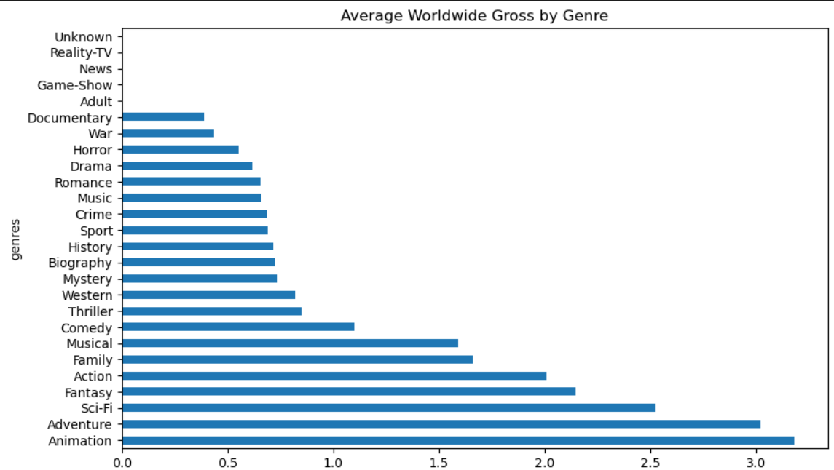
Analysis: Genres vs Box Office
Top revenue genres: Adventure, Animation, Fantasy, Sci-Fi
Genres strongly influence box office performance

Slide 7
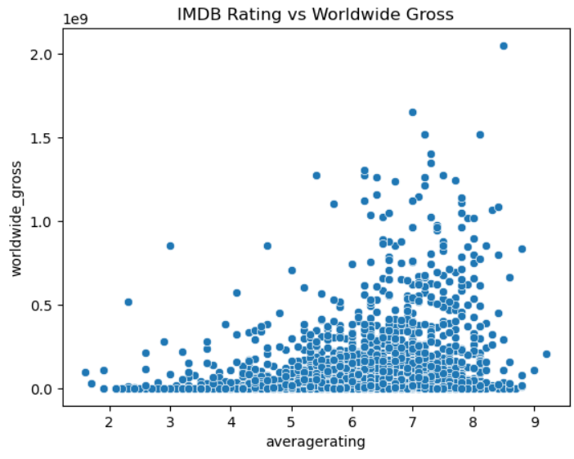
Analysis: Ratings vs Box Office
Weak but positive correlation found
High ratings don't guarantee high revenue
Non-critical factors drive many successes

Slide 8
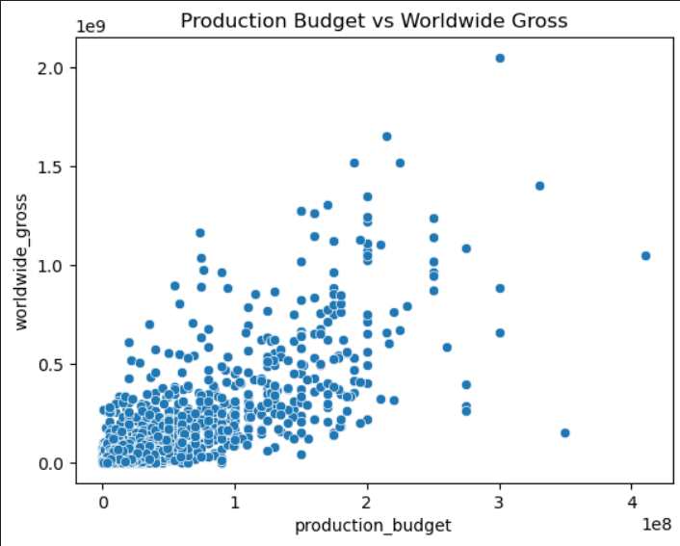
Analysis: Budget vs Box Office
Strong positive correlation
Larger budgets generally lead to higher revenue
Financial risk increases with budget

Slide 9

Business Recommendations
Prioritize Adventure, Animation, Sci-Fi & Fantasy
Use larger production budgets carefully
Ratings are helpful but not predictive

Slide 10
Thank You
Prepared By Group 1 Collaborators
Anthony Muthee Njiru
Beth Mwangi
Edwin Joshua
Mercy Chebet
Mirriam David
Jackline Theuri

